Slide 1
Sgroup meeting

Slide 2

K = 2 Fat-Tree

Slide 3
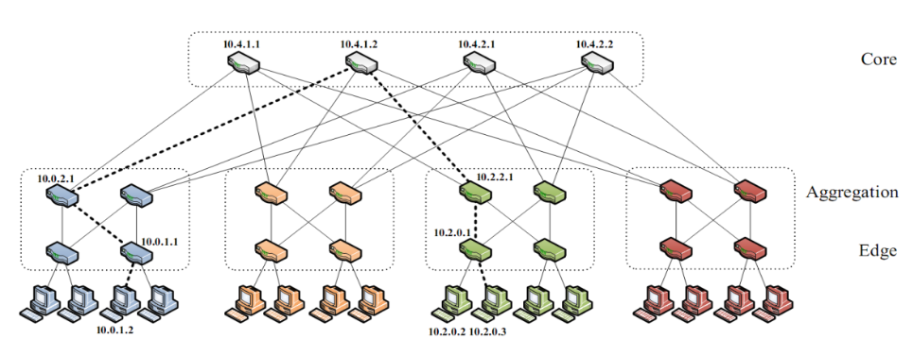
K = 4 Fat-Tree

Slide 4
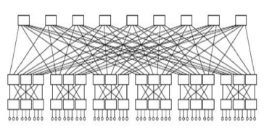
K = 6 Fat-Tree
36 37 38 39 40 41 42 43 44
18 19 20 21 22 23 24 25 26 27 28 29 30 31 32 33 34 35
0 1 2 3 4 5 6 7 8 9 10 11 12 13 14 15 16 17

Slide 5
K-path
To k = 2
Not efficient
To k = 4
Kp=1 vs Kp = 5
To k = 6
Kp = 1 vs Kp = 5 vs Kp = 10 vs Kp = 20
---------------------------------------------------------
Fat-Tree with different K

